Slide 1
E-safety workshop
Helping to keep your children safe online.

Slide 2


















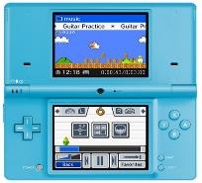





94% of 5-15 year olds live in a household with internet access and over a third of all 3-4 years old are accessing the internet in their homes.
Notes:
2
Children love using technology and are learning to navigate websites, online games and consoles, and touch screen technology like iPads and smartphones from a younger and younger age.
Latest Ofcom research has shown that 94% of 5-15 year olds live in a household with internet access and over a third of all 3-4 year olds are now accessing the internet in their homes. We know that children need support in these environments, to get the best out of using the internet, and there are real advantages in making sure that children are supported in their internet use right from the start.

Slide 3
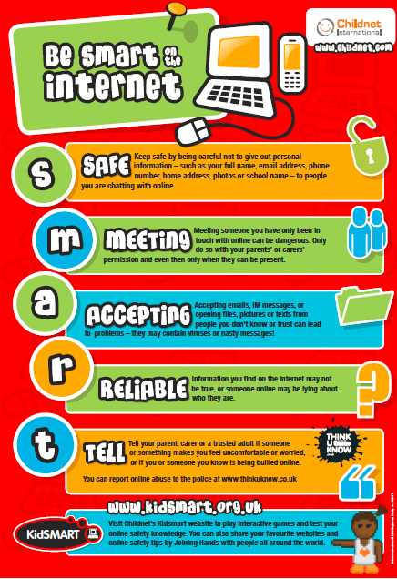
Notes:
We teach our children the SMART rules and these are displayed in all our classrooms as a reminder of how to stay safe online.
S - Keep SAFE Don't give out your personal information when you are online. This includes your name, email address, phone number and passwords.
M - Don’t MEET up Never meet up with someone you only know online, this can be dangerous. People you have been talking to online are still strangers, even if you have been talking to them for a long time.
A - ACCEPTING emails, files, pictures or messages can be dangerous Don't accept emails, messages, or open files, pictures or texts from people you don't know.
R - RELIABLE Not all people are reliable, they might not be who they say they are. Always check information with someone who knows, books or other websites.
T - TELL Someone Always tell a parent, carer, friend or trusted adult if you feel uncomfortable or worried.

Slide 4


Join in with Mummy Penguin’s song and follow the adventures of Smartie the Penguin as he learns how to be safe on the internet. The story covers the following 3 themes;- Pop ups and in app purchasing - Inappropriate websites for older children - Cyberbullying
Help arrives just in time for Digiduck® when faced with a difficult decision! Follow Digiduck® and his pals in this story of friendship and responsibility online. The Digiduck® collection has been created to help parents and teachers educate children aged 3 - 7 about how to be a good friend online. The collection now includes a book, PDF and interactive app.

Slide 5





Just some of the benefits of using technology:
Better hand-eye coordination
Improves language skills
Increases motivation to complete tasks
Develops problem solving skills
Develops skills and talents

Slide 6
Using apps / games
Things to consider

Slide 7
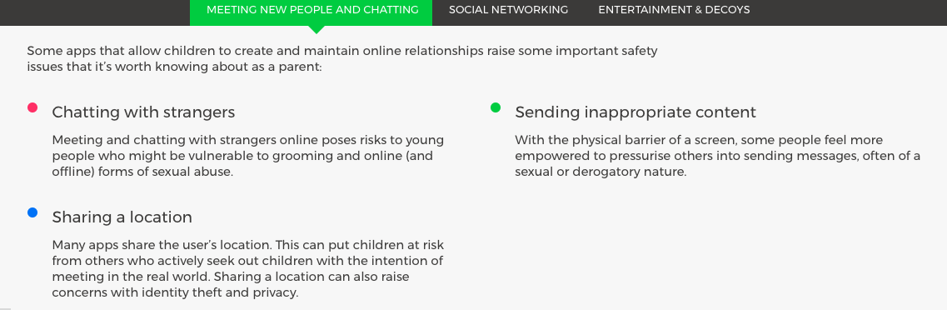
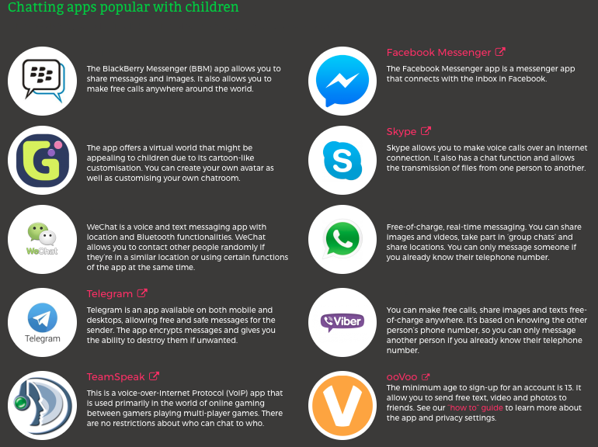

Slide 8
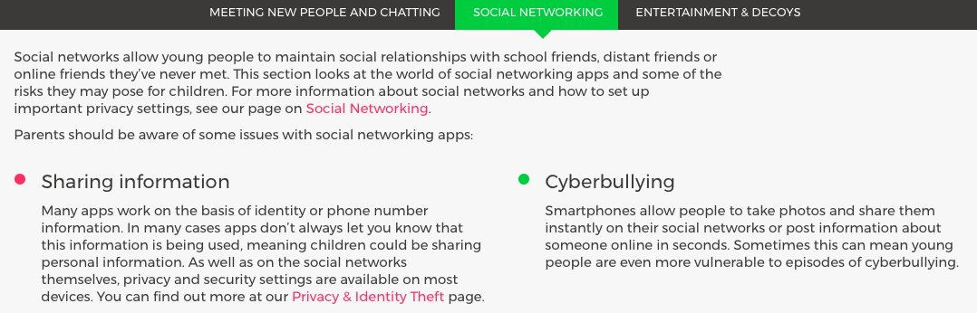
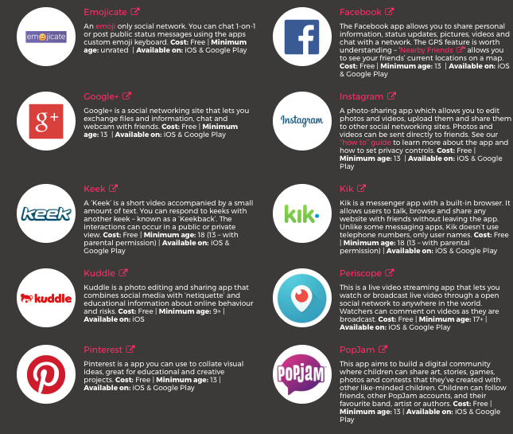

Slide 9
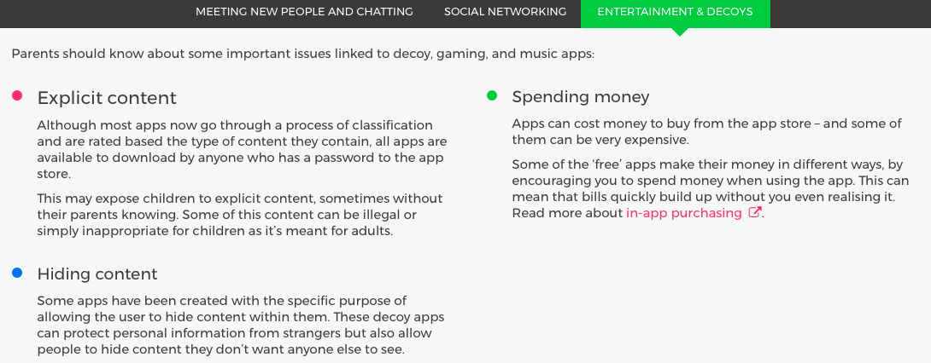

Slide 10
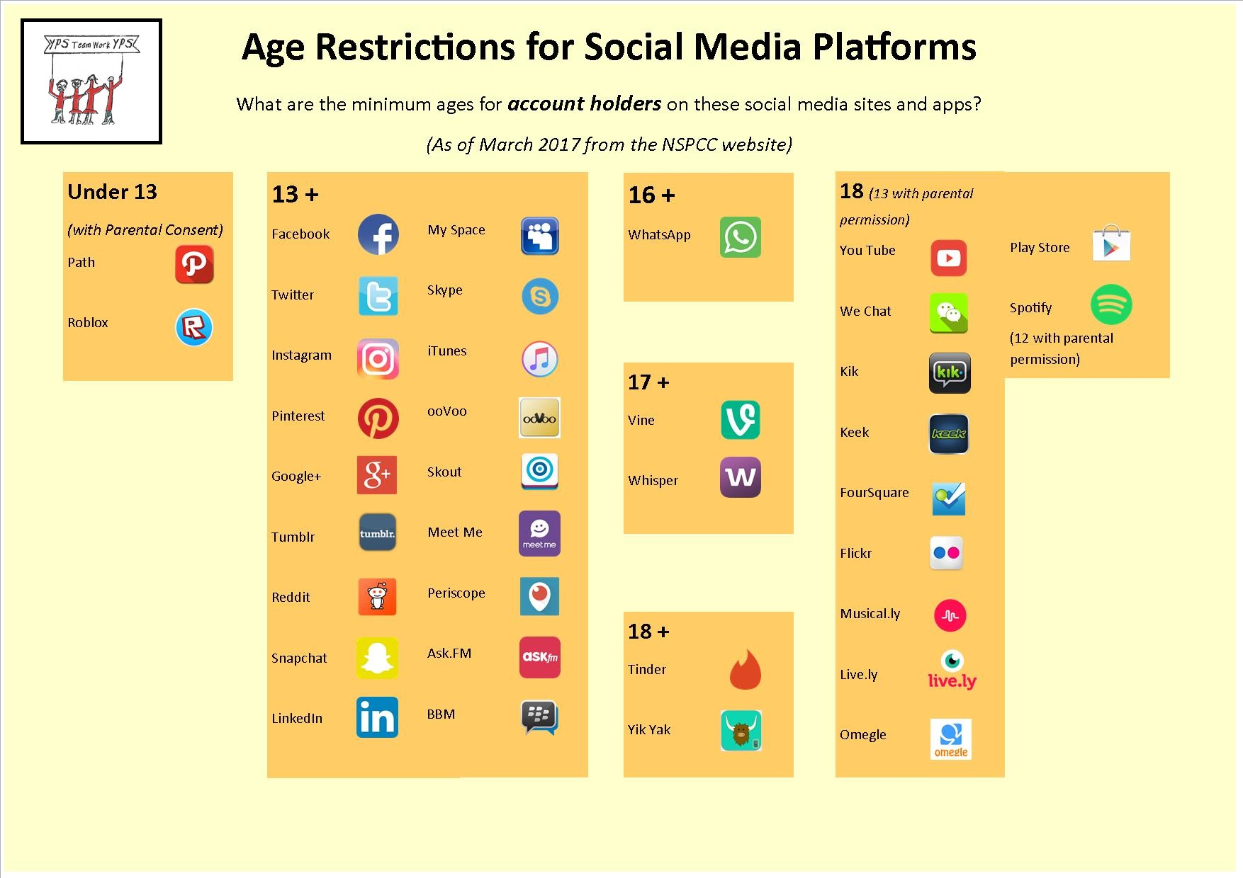

Slide 11





Gaming
http://www.pegi.info
Advice, Good Gaming Guide pdf

Slide 12
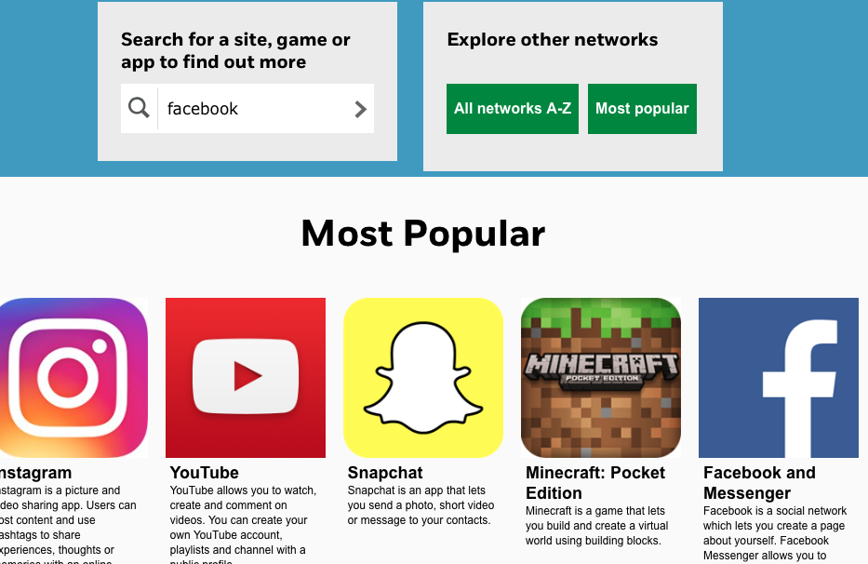
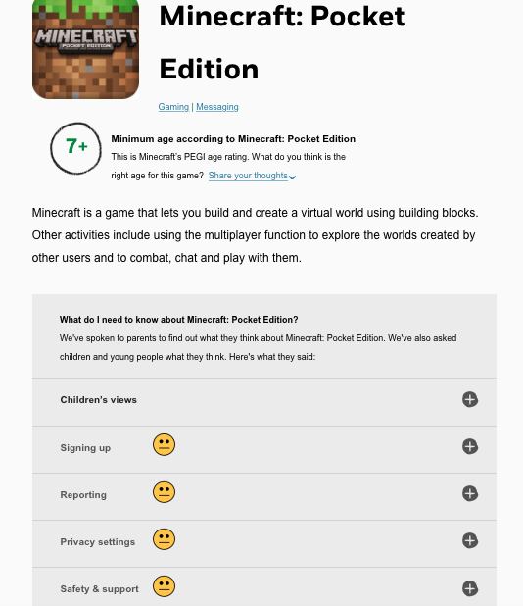
https://www.net-aware.org.uk
Allows you to search for a site, game or app to find out more about it.

Slide 13
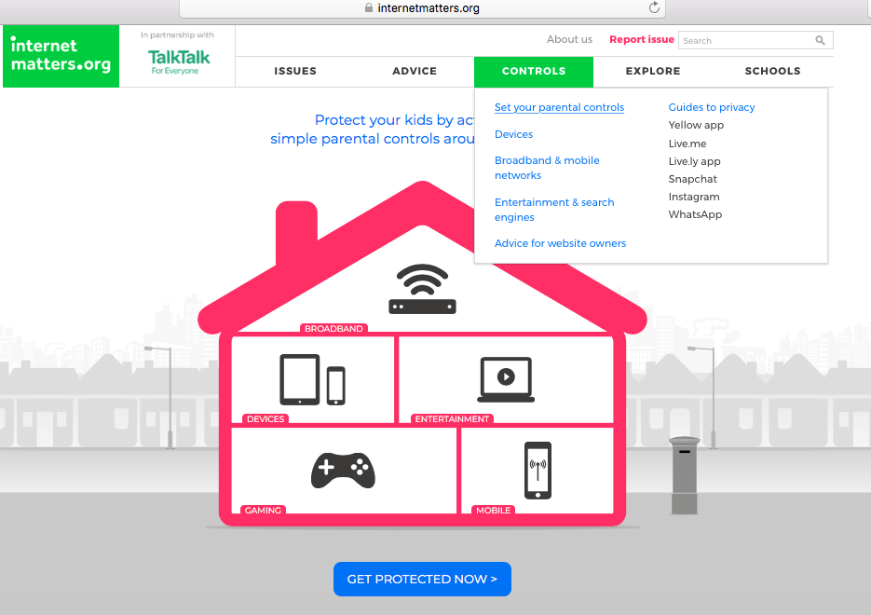
Setting up parental controls
www.internetmatters.org

Slide 14
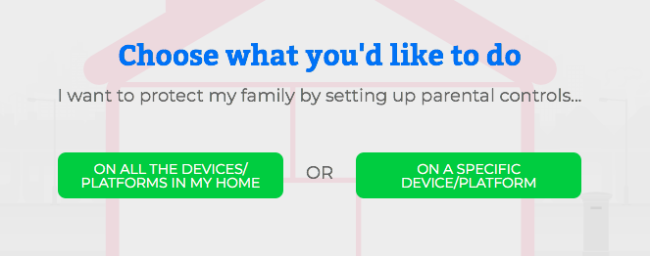

Slide 15
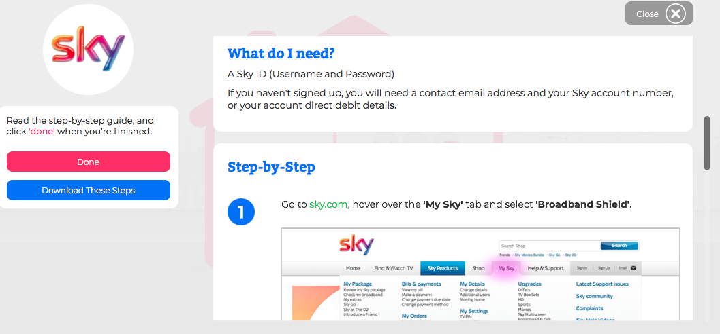

Slide 16

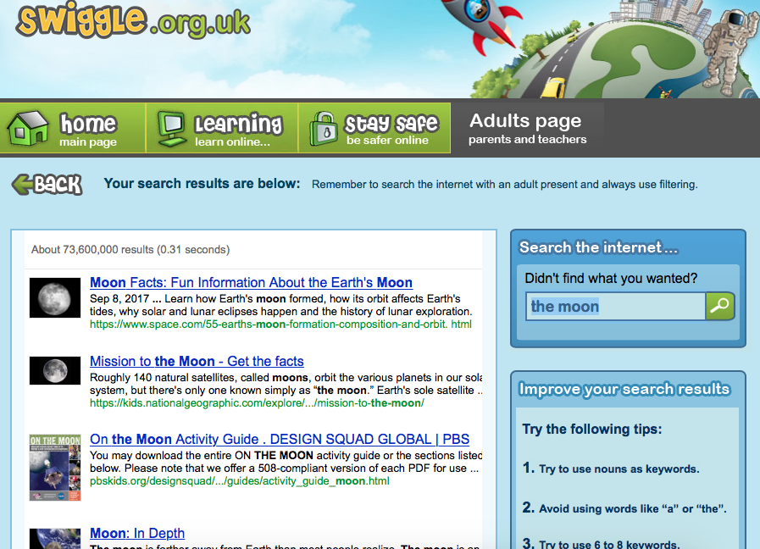

Slide 17
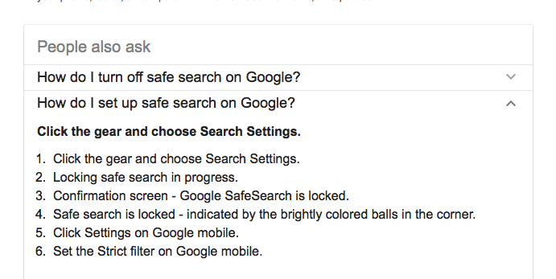

Slide 18
